Slide 1
University OF TRANSPORT
HO CHI MINH CITY UNIVERSITY OF TRANSPORT
Academic Year: 2025 - 2026
Course Code: 011968115401
Object-Oriented Programming
TOPIC: CPU Scheduling Algorithms: (FCFS and Non-Preemptive SJF)
Lecturer: Mai Ngoc Chau
Group Members:
Le Hoang Minh Khang - 082206004707
Luong Minh Hieu - 079206015033
Nguyen Nhat Toan - 079206045477
Le The Huy - 083206000728
Pham Nguyen Gia Bao - 079206004263

Slide 2
Project Introduction
Project Link:
https://github.com/MinhKhang18-04/011968115401-Group07-ProjectCode
Project Overview
This project implements a CPU Scheduling Algorithm Simulator, demonstrating two fundamental scheduling algorithms:
First-Come, First-Served (FCFS)
Shortest Job First Non-Preemptive (SJF)
The application is developed using the C++ programming language and runs as a console application on Windows/macOS/Linux.

Slide 3

Project Objectives
1
2
3
Understand Concepts
Implement Algorithms
Compare Performance
Grasp CPU scheduling concepts in Operating Systems.
Execute FCFS and SJF scheduling algorithms.
Evaluate algorithm performance using different metrics.
4
5
Visualize Results
Programming Practice
Display scheduling results using Gantt Chart.
Practice modular programming and code organization.

Slide 4





Technologies Used
Programming Language
C++
Development Environment
Visual Studio Code
Version Control
Git/GitHub
Libraries
csv, copy, datetime, time, random (built-in)

Slide 5
Algorithm Theory: FCFS
FCFS Algorithm (First-Come, First-Served)
Principle: Processes that arrive first are executed first.
Characteristics:
Non-preemptive scheduling
Simple and easy to implement
Fair based on arrival order
Can cause "convoy effect" (short processes wait for long processes)
Example:
PID
AT
BT
ST
CT
TAT
WT
P1
0
5
0
5
5
0
P2
2
4
5
9
7
3
P3
3
9
9
18
15
6
P4
6
2
18
20
14
12
Average Waiting Time: 5.25
Average Turnaround Time: 10.25

Slide 6
Algorithm Theory: SJF
Non-preemptive SJF Algorithm (Shortest Job First)
Principle: Among the arrived processes, execute the process with the shortest execution time first.
Characteristics:
Non-preemptive scheduling
Optimal average waiting time
Can cause "starvation" (long processes may never get executed)
Requires prior knowledge of execution time
Example:
PID
AT
BT
ST
CT
TAT
WT
P1
0
5
0
5
5
0
P4
3
2
5
7
4
2
P3
1
4
7
11
10
6
P2
2
9
11
20
18
9
Average Waiting Time: 4.25
Average Turnaround Time: 9.25

Slide 7






System Design
Project Structure
The project is organized into clear directories for assets, documentation, and source code, ensuring maintainability and scalability.
Program Flow
Start
Read CSV
Show Input
Run FCFS
Run SJF
The program flow begins by reading data from a CSV file, then executes and displays the results of both FCFS and SJF algorithms, finally comparing their performance.

Slide 8
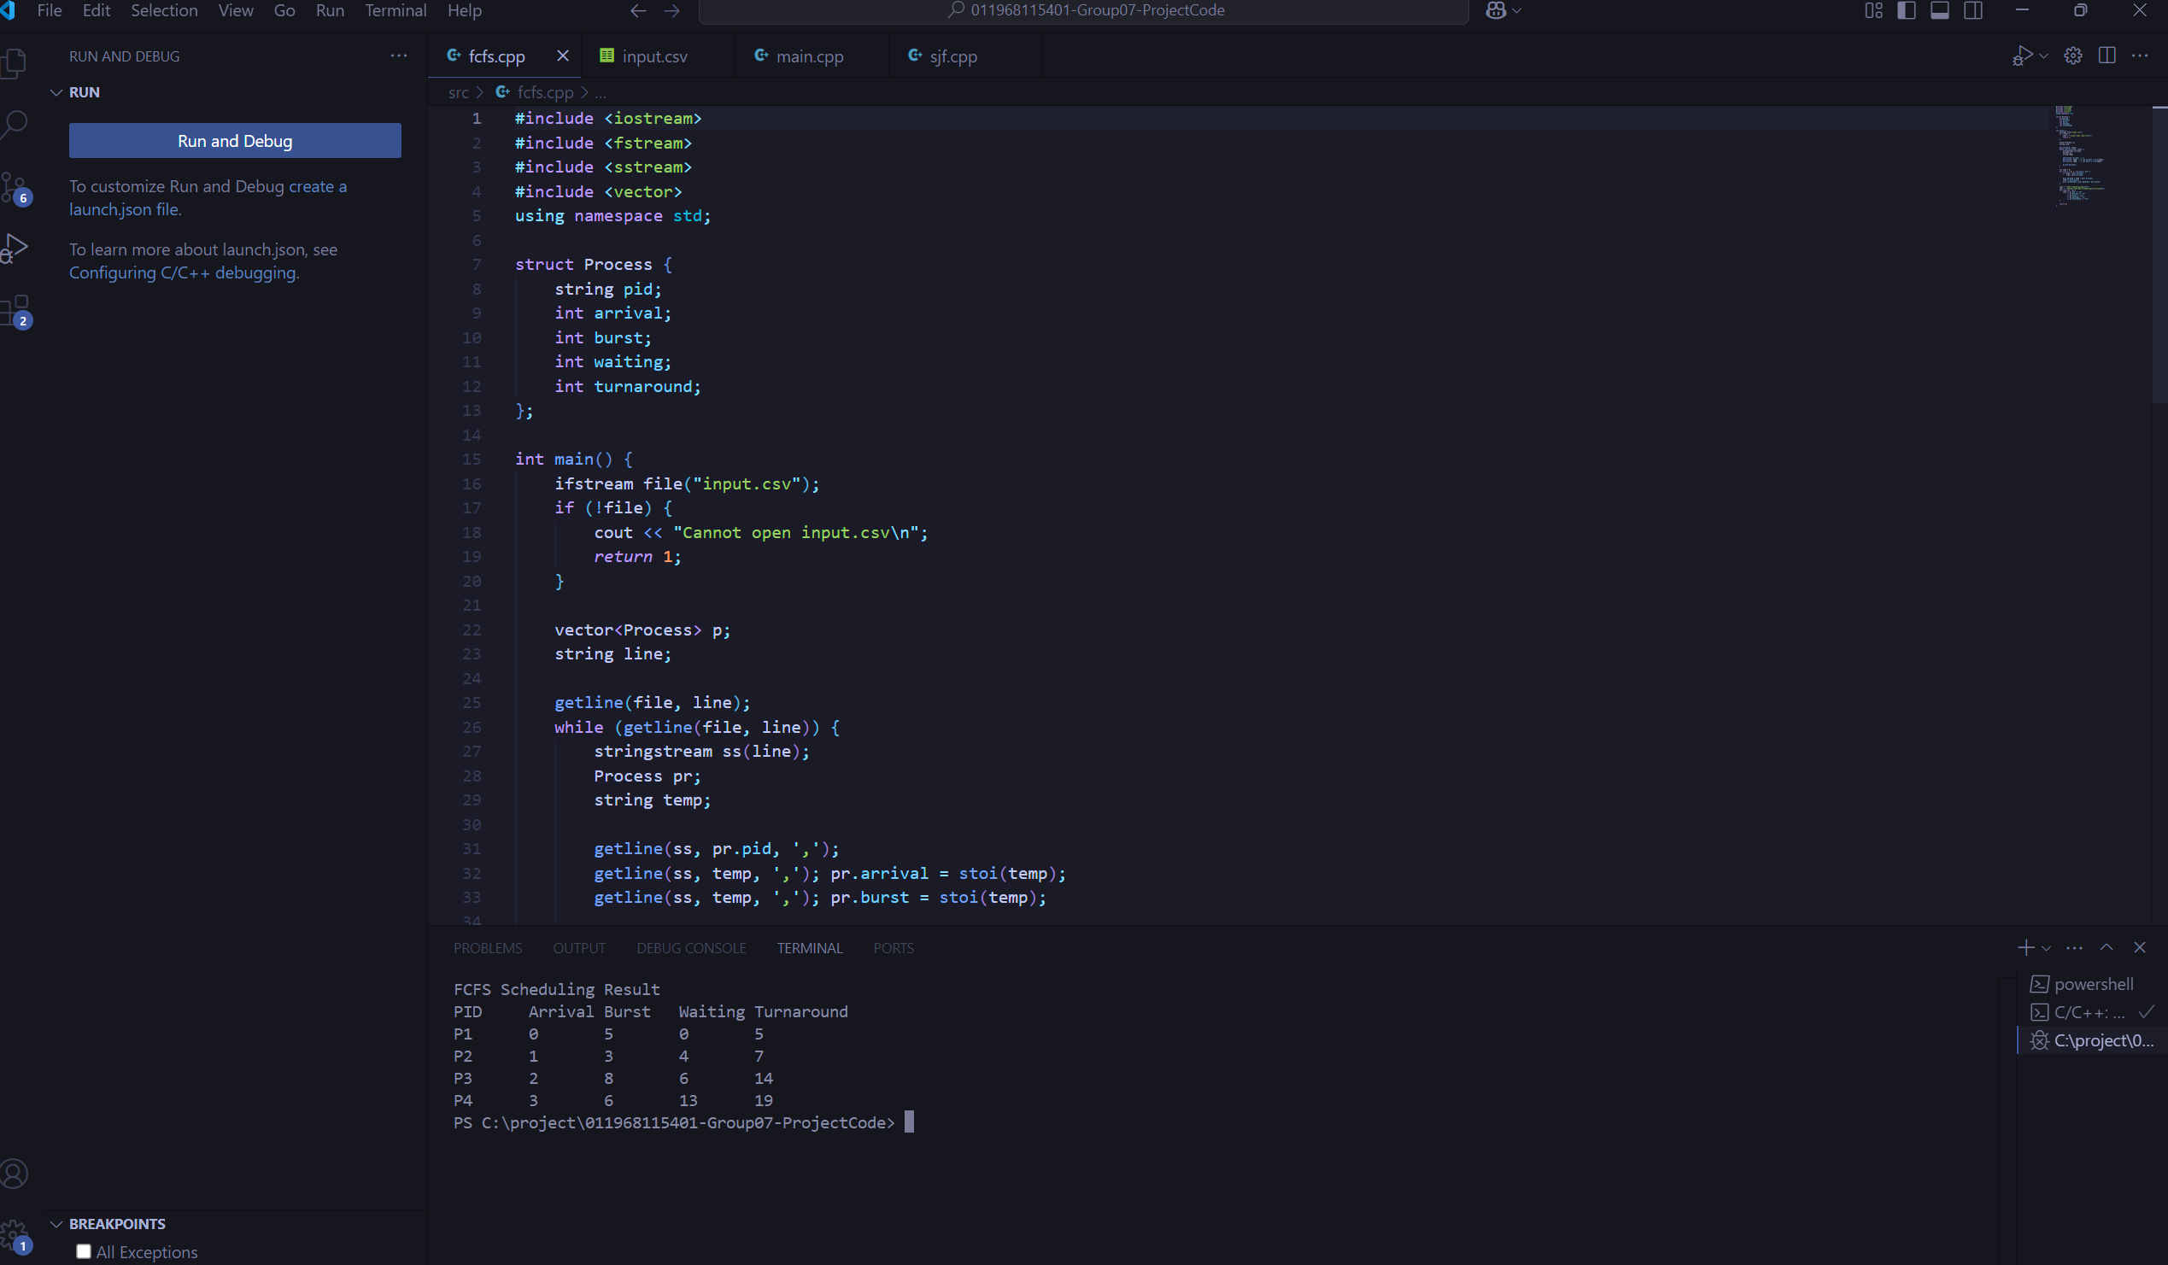
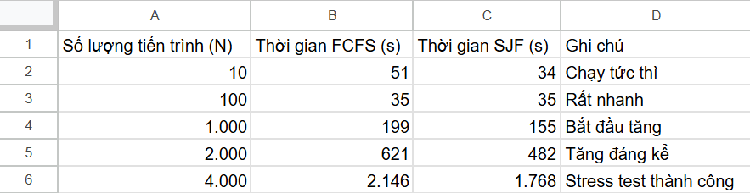
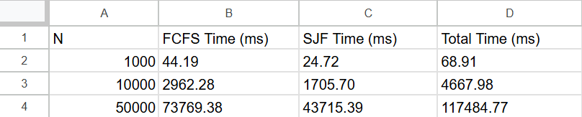
Stress Test Performance Test And Proof
- main screen test
- performance test ( with N= 1000 , 10000 , 50000)

Slide 9

Challenges Encountered
Understanding the Algorithm
Creating Gantt Charts
Determining the correct execution order based on arrival time and execution time.
Requires careful calculation and attention to detail.
Calculating Time
Comparing Algorithms
Calculating waiting time and turnaround time for each process.
Performance analysis requires a deep understanding of the concepts.
What We Learned
This project has deepened our understanding of CPU scheduling algorithms, improved our C++ programming skills, CSV file handling, and teamwork.

Slide 10
Work Assignment
Schedule of work assignments and performance evaluation of team members:
No.
Name
Assigned Task
Completion Rate
Signature
1
Lê Hoàng Minh Khang
Team Leader
100%
2
Lương Minh Hiếu
Tester
100%
3
Nguyễn Nhật Toàn
Programmer
100%
4
Lê Thế Huy
Designer
100%
5
Phạm Nguyễn Gia Bảo
Writer
100%

Slide 11
Conclusion
This project successfully implemented and analyzed CPU scheduling algorithms, particularly FCFS and SJF. Through practical implementation and testing, we gained an understanding of how different scheduling strategies impact system performance in terms of waiting time and turnaround time.
The project also enhanced our programming skills, especially in C++ and file handling, and reinforced important operating system concepts. Overall, this project provided valuable practical experience and a solid foundation for understanding process scheduling in operating systems.
References
A. Silberschatz, P. B. Galvin, and G. Gagne, Operating System Concepts, 10th ed. Wiley, 2018.
A. S. Tanenbaum and H. Bos, Modern Operating Systems, 4th ed. Pearson Education, 2015.
W. Stallings, Operating Systems: Internals and Design Principles, 9th ed. Pearson, 2018.
GeeksforGeeks, “CPU Scheduling in Operating Systems,” Online resource.
TutorialsPoint, “Operating System – CPU Scheduling,” Online resource.

